Slide 1

WP2.B Guidelines for National Report - EYDP
Project Number: 2022-1-PT01-KA220-SCH-000086979
EuroEd Primary School
Iași, Romania
andrei.bordeianu@euroed.ro

Slide 2
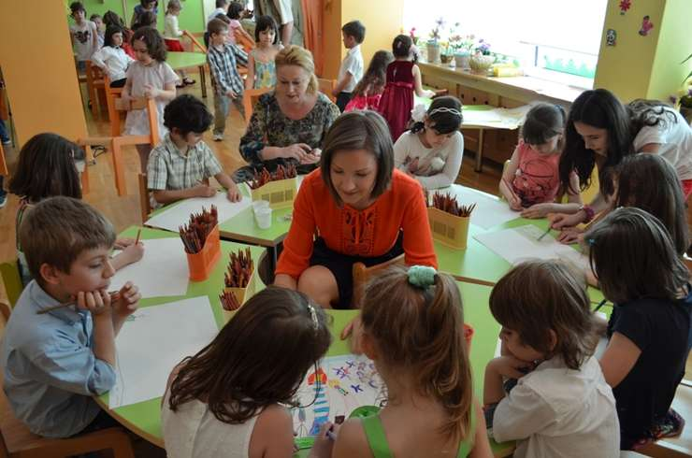
This report is reviewing the situation of the childhood education in Romania, with focus on the evaluation process.

Slide 3
Introduction
The main goal of the preschools assessment is to improve the educational process and not to reach certain data.
Romania has it’s on particularities: before 1989 the education system was highly politicized.
The post-comunist education system can be outlined as follows: 1990-1997; 1997-2000; 2000-2010; 2010-present.

Slide 4

The pre-school education in Romania is particularly focused on various skills of the child: harmonious development of the child's personality through various interactions with peers, knowledge of one's own identity through essential questions etc.
Notes:
6

Slide 5
The legal framework
1. The pedagogical component
2. The evaluation and Romania
The legal framework in which the whole educational process is carried out is represented by the National Education Law, no.1/2011 of 5 January 2011.
The most important articles for us are:
“Art. 102. - (2) In the pre-university education system, the assessment focuses on competences, provides real feedback to students, parents and teaching staff and is the basis of individual learning plans.
Art. 106. (1) The evaluation results are expressed, as appropriate, by: a) descriptive assessments regarding the child's development - at the preschool, preschool and preparatory class levels
Art. 107. - (1) For the preschool and preschool levels, the results of the evaluation are communicated and discussed with the parents or legal representatives.”

Slide 6
Examples of kindergarten teachers' practices on children evaluation and documentation in Romania
The most common forms of assessment are: initial, continuous and final assessment.
The data obtained from the initial assessment helps to establish the appropriate way of teaching the new content of the program, organizing a recovery program (if necessary) and adopting certain measures.
Oral test are the most used assessment methods in kindergarten *direct interaction*
The role of the parents in the process should not be overlooked.

Slide 7
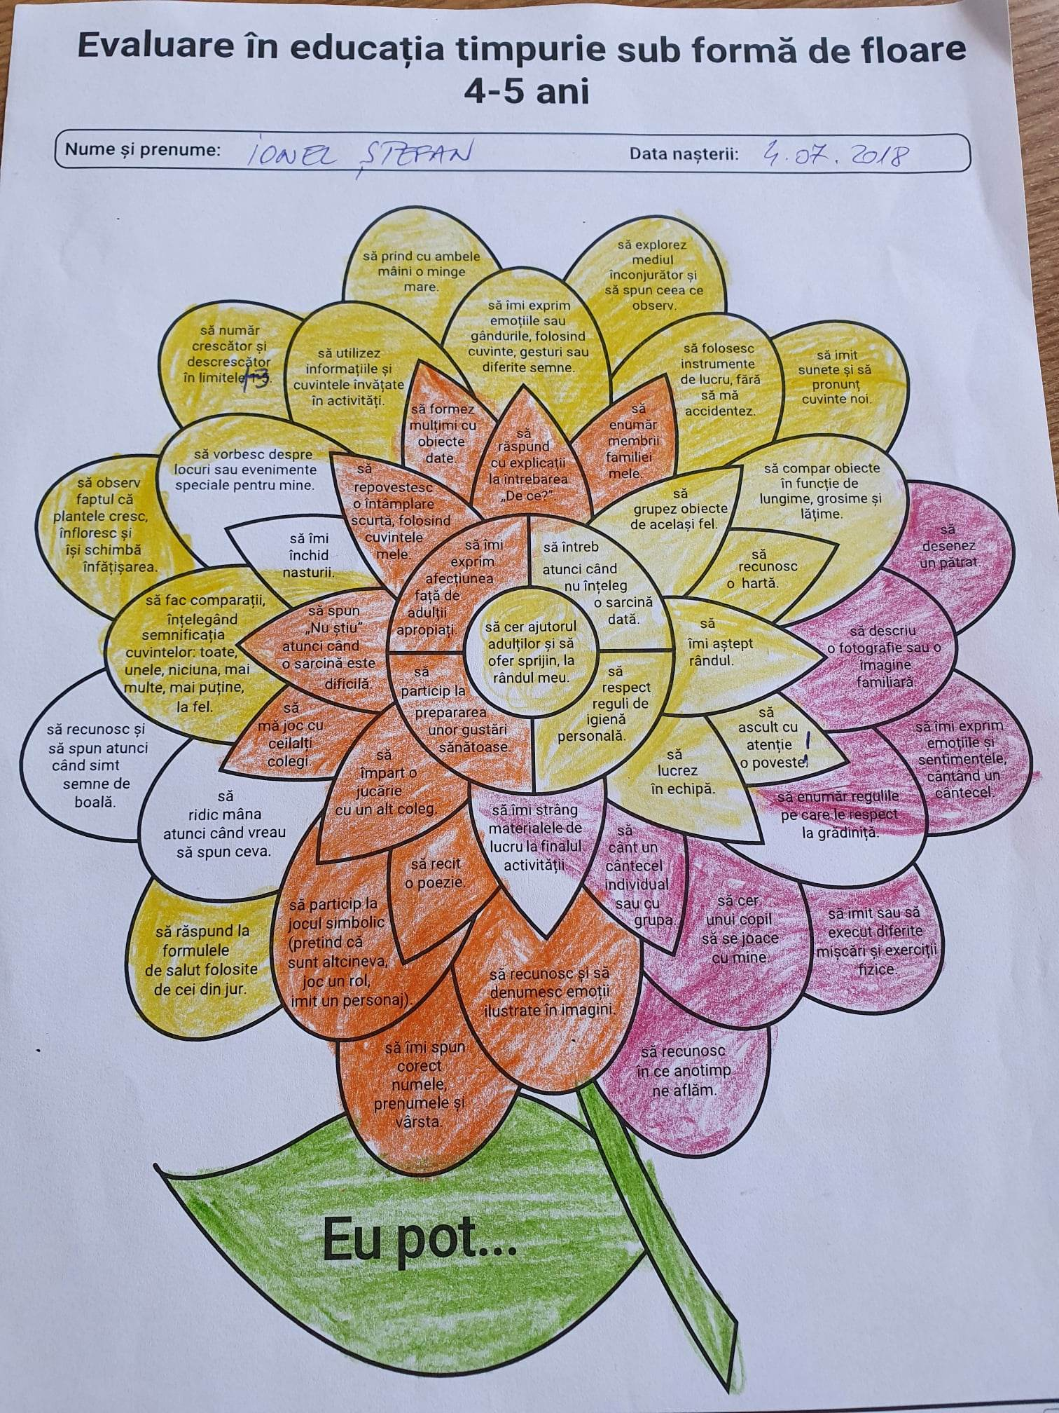

Slide 8
References
Florentina-Lavinia, Matei, The Romanian Curriculum of Early Education and Primary Education. https://www.researchgate.net/publication/361065113_The_Romanian_Curriculum_of_Early_Education_and_Primary_Education/link/629a8dbe55273755ebd07572/download
Horațiu Catalano, Verity Campbell-Barr, The occurrence of pretend play in early childhood education in Romania – an investigative study, 2019. https://www.tandfonline.com/doi/abs/10.1080/03004430.2019.1621306
Laura Arhiri, Mihaela-Alexandra Gherman, Romanian Parents’ and Kidergarten Teachers’ Social Representations of the Development of Intelligence in Children. https://www.psih.uaic.ro/anale-psih/wp-content/uploads/sites/10/2021/01/Social-Representations-of-the-Development-of-Intelligence-in-Children.pdf
Ordinul nr. 5447/2020 privind aprobarea Regulamentului-cadru de organizare şi funcţionare a unităţilor de învăţământ preuniversitar. https://lege5.ro/Gratuit/gm4dgojvgmza/ordinul-nr-5447-2020-privind-aprobarea-regulamentului-cadru-de-organizare-si-functionare-a-unitatilor-de-invatamant-preuniversitar
Manea, M. (2018). Assessment in preschool education. https://edict.ro/evaluarea-in-invatamantul-prescolar
Popa, R. O., Bucur, N. F. (2016). Past and present in the Romanian primary education curriculum. Conference Challenges of the Knowledge Society. Education and sociology: Bucharest. https://www.researchgate.net/

Slide 9
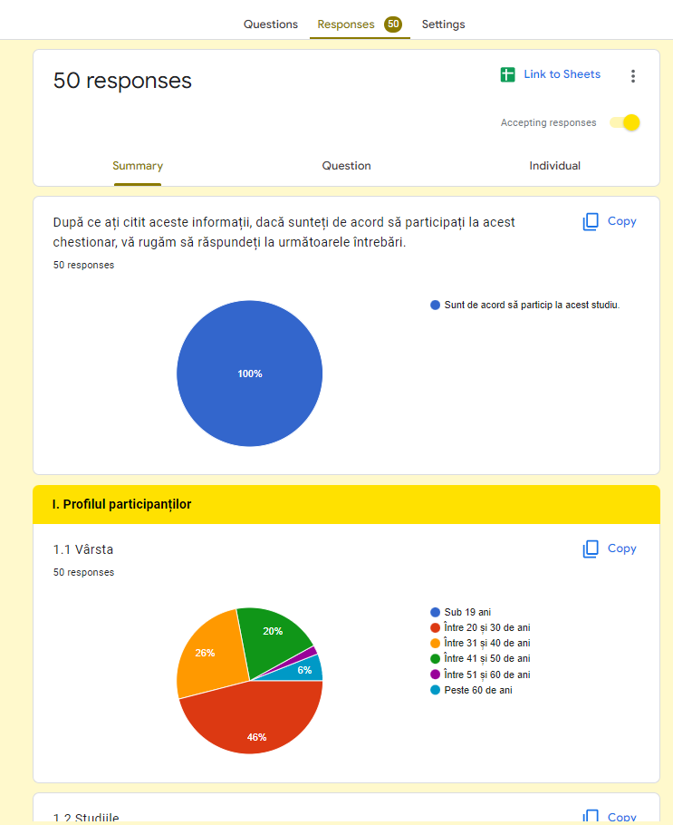
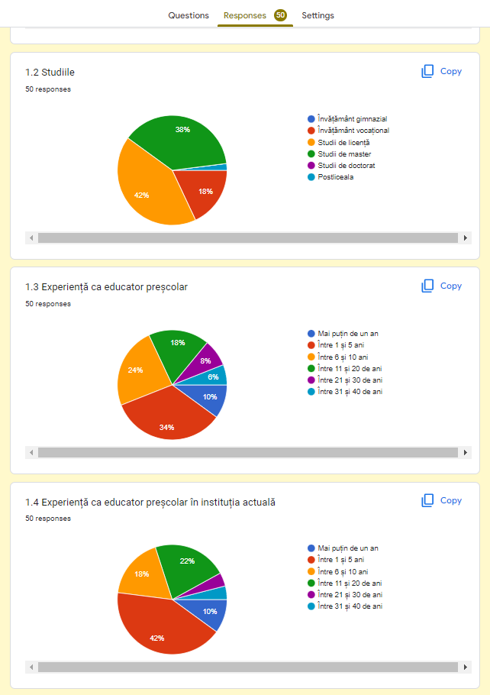
„

Slide 10
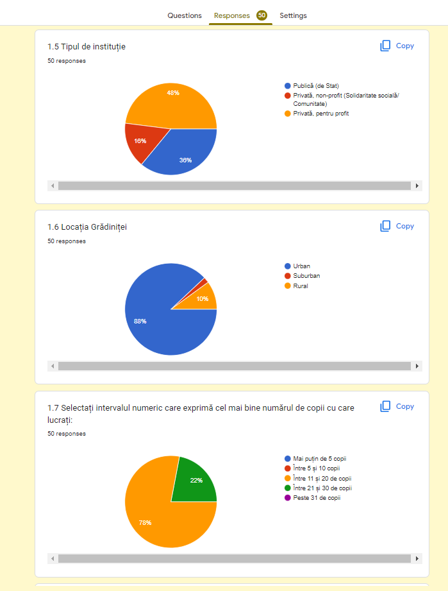
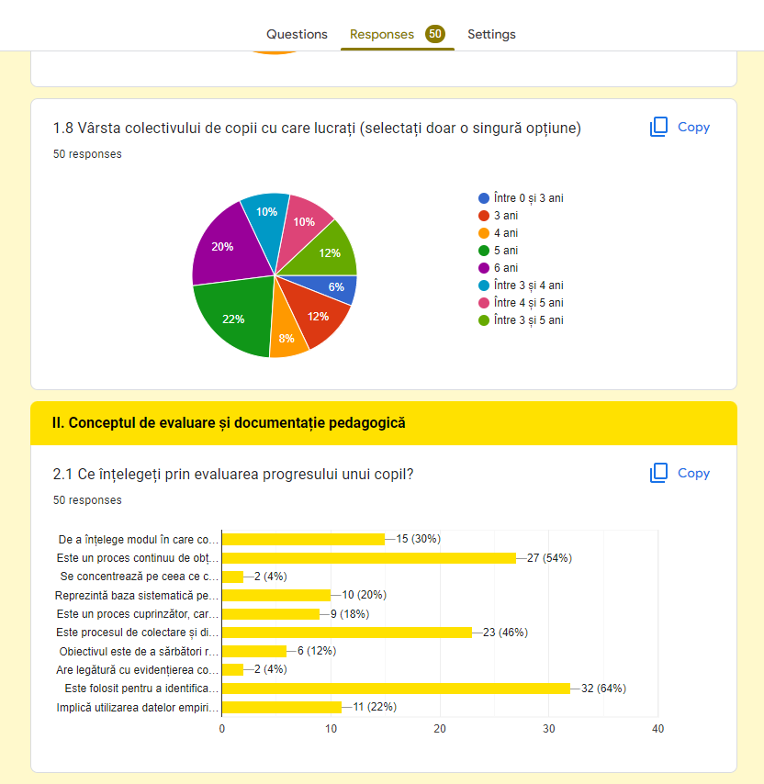

Slide 11
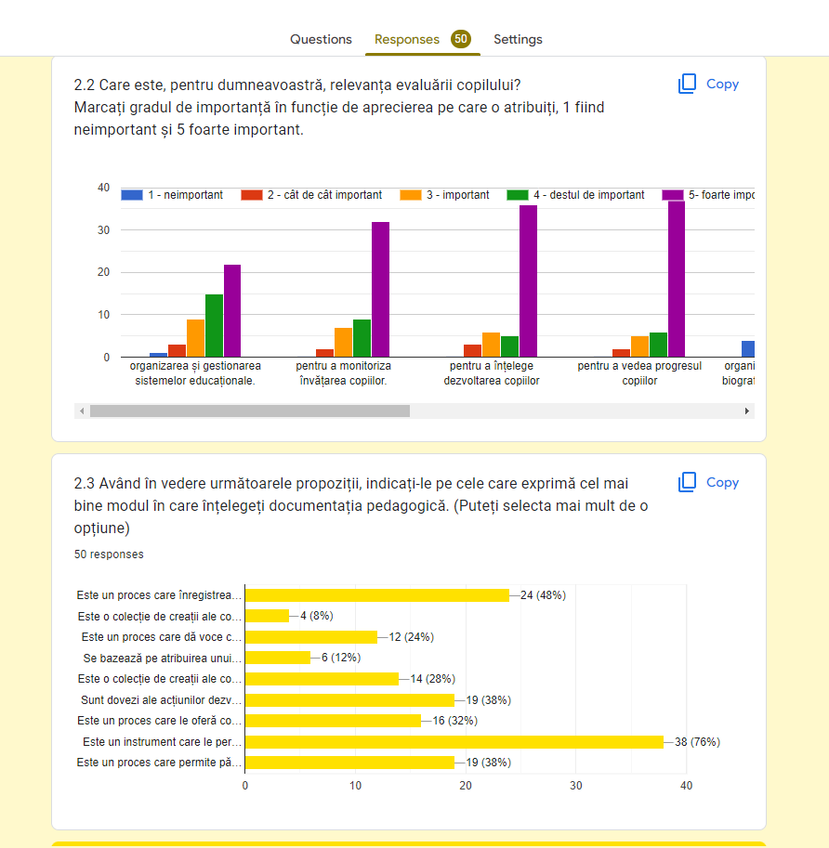
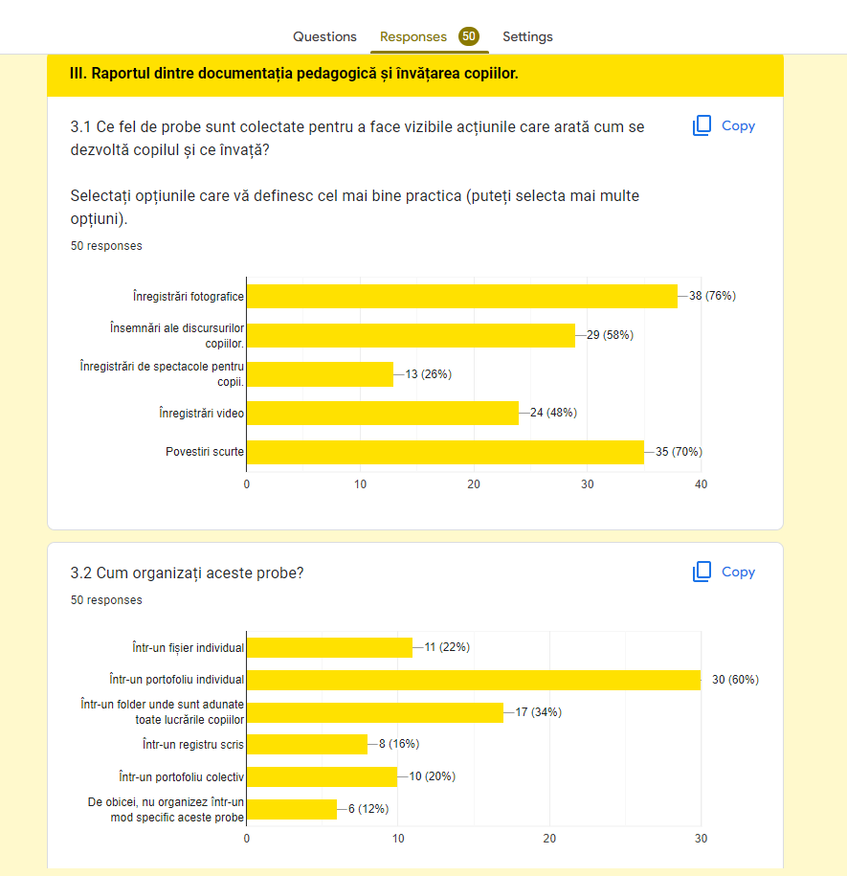

Slide 12
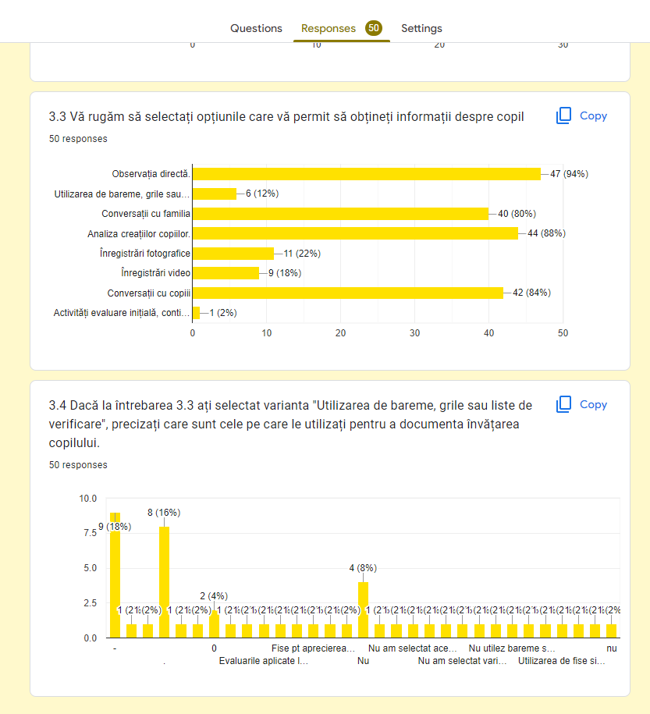
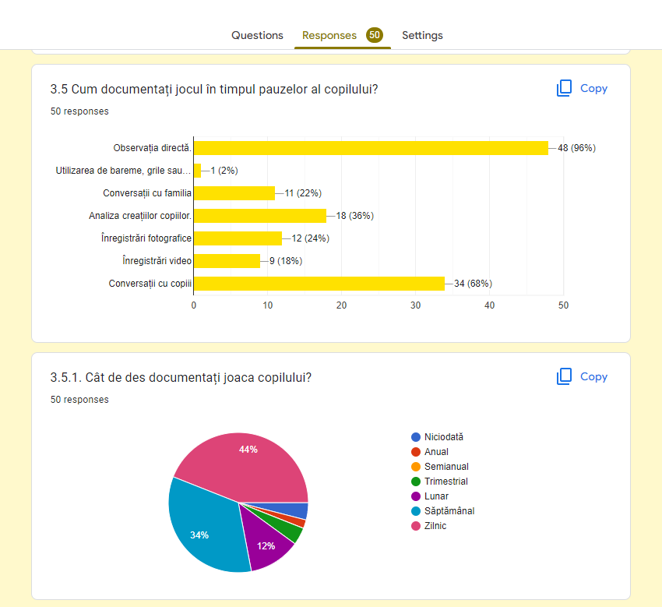

Slide 13
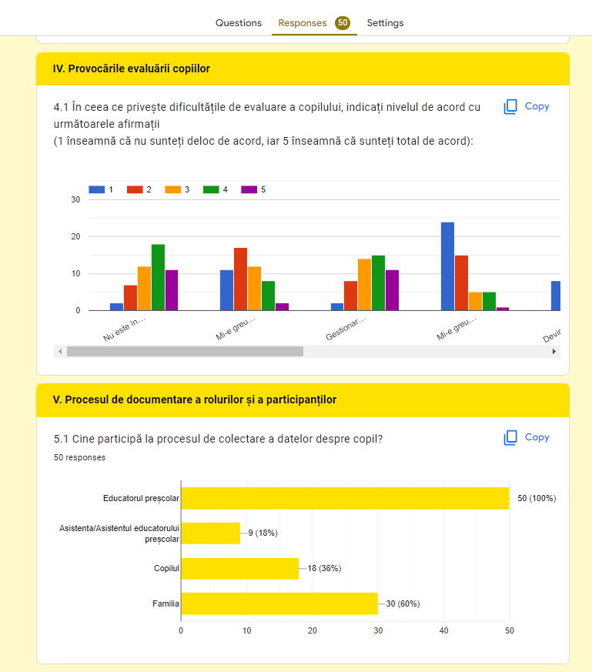
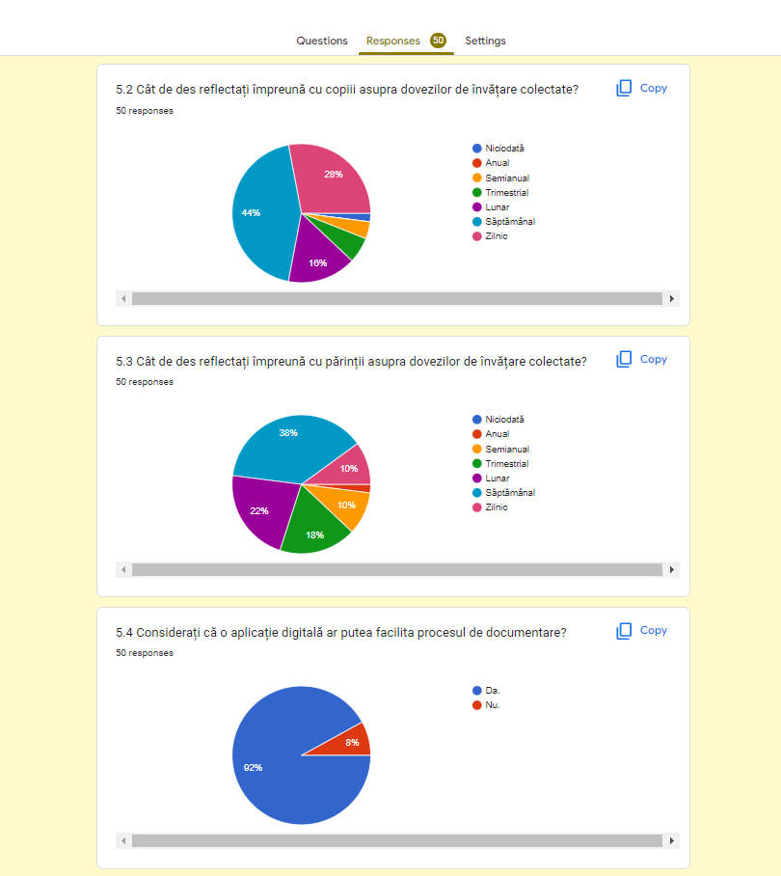

Slide 14
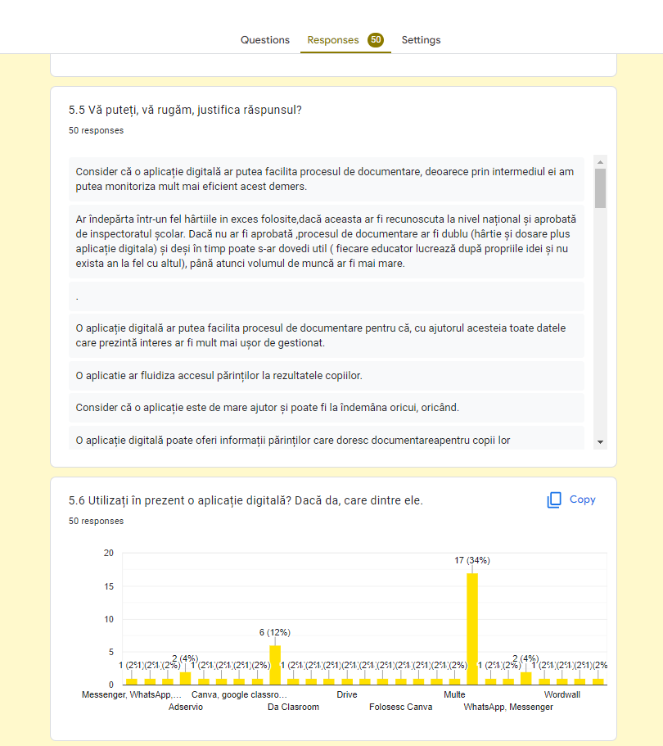
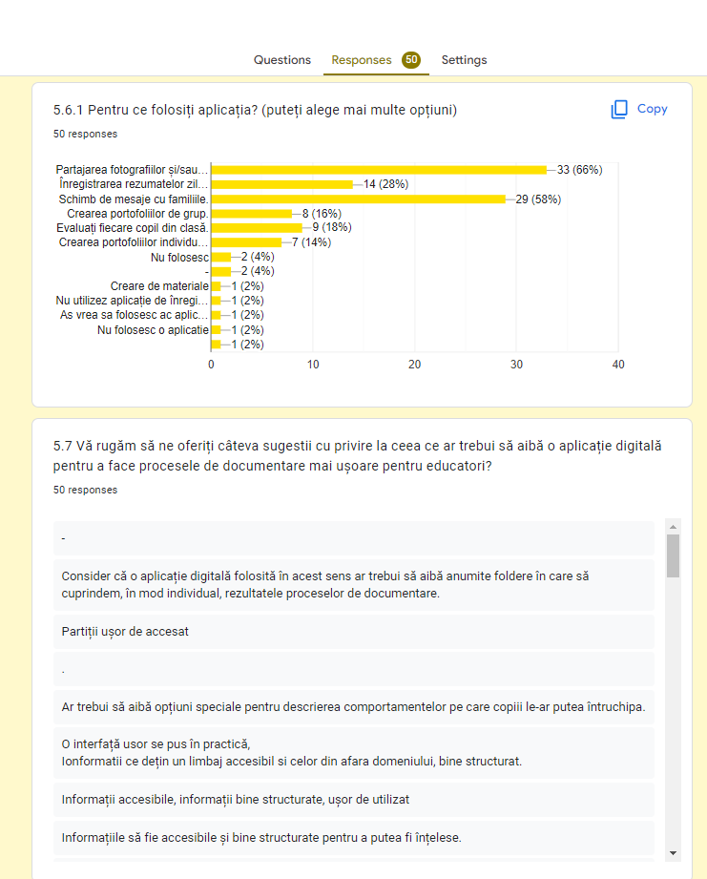

Slide 15


